Slide 1
Inventory Par Level – Finding the Right Fit
Data Analytics Boot Camp Final Project – June 2019

Slide 2
01
Inventory management
What does inventory management look like in a hospital setting?
02
Problem Case
What is the Operational Issue in Question and Proposed Solution?
03
Data & Creative Problem Solving
What Methods and Tools are being used to Solve the Issue at Hand?
04
Conclusion
Next Steps?

Slide 3
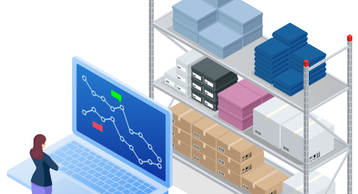
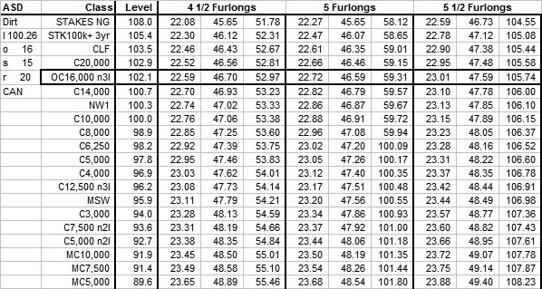

Inventory Management
Inventory management is a component of supply chain management that involves supervising non-capitalized assets, or inventory, and stock items
Inventory Management tracks a product from entrance into organization to end user/customer
There are several different methods of inventory management
PAR Levels
Background Info
PAR – Periodic Automatic Replenishment
the expected minimum inventory quantity required to held in the warehouse to ensure that the customers supply requirements met
Criteria for setting proper par levels can vary dramatically & set arbitrarily
PAR Levels usually remain static or fixed for long periods of time
Challenges Specific to healthcare
Hospitals historically have had little to no criteria in place for setting PAR levels.
Lack of stock isn’t an inconvenience or just money loss, but a potential impact on patient care and a person’s life.
Huge factor in data constraints and system limitations.

Slide 4
Problem Case - Methodology
How do WE solve this ISSUE?
Looking at the System & Data
Reports housed in SQL Server –Par Report & P.O. History
Identify Potential Test Case
Which part numbers are being ordered?
Preliminary Analysis
Look at ‘Current State’ of the selected test case
Data Analytics
Data Cleaning, Testing, Training, Analysis
Findings
Future state, Caveats, Next Steps

Slide 5
Conclusion
Understanding & Acknowledging the limitations in the data
Recognizing the benefits of Par level rightsizing
Consumption Rate
On –Hand Inventory
Increased Liability (expiration or damage)
Overstock ties $$ on shelf
FTE time wasted
Limited storage space
In conclusion, incorporating all variables and data points will increase the confidence level of the model. With a higher confidence level, recommendation of new par levels can be set for every item in inventory. Realized hard $$ savings can be calculated by looking at the amount of reduced inventory on hand and the redistribution of labor cost; in addition to soft savings from reduced liability & increased storage bandwidth.

